Slide 1
Modularization

Slide 2
Modularization techniques is used to avoid repetitive coding.
The advantage of modularization is:
Readability.
Code reusability.
Providing structure to our code.
Organizing ABAP code can be done by using INCLUDE reports and local MACRO's (DEFINE statement). Typical examples can be found in Module Pools and Function Groups with TOP-includes and special includes for PBO events, PAI events etc.

Slide 3
5 types
Macros
Includes
Subroutines
Function modules
Methods

Slide 4
Macros :
If you want to reuse the same set of statements more than once in a program, you can include them in a macro.
Syntax :
DEFINE <macro>.
<statements>
END-OF-DEFINITION.
To use a macro, use the following form:
<macro> [<p1> <p2> ... <p9>].

Slide 5
Ex :
DATA : result TYPE I,
N1 TYPE I VALUE 6,
N2 TYPE I VALUE 5.
DEFINE OPERATION.
RESULT = &1 &2 &3.
OUTPUT &1 &2 &3 RESULT.
END-OF-DEFINITION.
DEFINE OUTPUT.
WRITE :/ ' THE RESULT OF &1 &2 &3 =' , &4.
END-OF-DEFINITION.
OPERATION N2 + N1.
OPERATION N2 - N1.
OPERATION N2 * N1.

Slide 6
Include
Include programs allow you to manage complex programs in an orderly way. Function groups and module pools use include programs to store parts of the program that belong together. The ABAP Workbench supports you extensively when you create such complex programs by creating the include programs automatically and by assigning them unique names.
Include Programs :
These are sub-programs which contains a set of re-usable statements .
These programs can not be executed directly.
These include programs must be embedded inside a main program for execution.
These programs dosen`t contain parameter interface, that is no importing and exporting parameters.

Slide 7
Syntax :
INCLUDE <include name>.
Example:
TYPES : BEGIN OF TY_MARA,
MATNR TYPE MARA-MATNR,
MTART TYPE MARA-MTART,
MEINS TYPE MARA-MEINS,
MBRSH TYPE MARA-MBRSH,
END OF TY_MARA.
DATA : IT_MARA TYPE TABLE OF TY_MARA.
DATA : WA_MARA TYPE TY_MARA.
SELECT MATNR MTART MEINS MBRSH FROM MARA INTO TABLE IT_MARA.
LOOP AT IT_MARA INTO WA_MARA .
WRITE :/ WA_MARA-MATNR, WA_MARA-MTART, WA_MARA-MEINS, WA_MARA-MTART.
ENDLOOP.

Slide 8
Using include.
INCLUDE ZMAIN.
INCLUDE ZSELCTION.
INCLUDE ZPRINT.

Slide 9
Subroutines
A subroutine is a block of code introduced by FORM and concluded by ENDFORM.
Subroutines are normally called internally, i.e. called from the same program in which it is defined. But it is also possible to call a subroutine from an external program.
A subroutine can be called using PERFORM statement.
2 types :
External subroutines.
Internal subroutines.

Slide 10
Internal Subroutines :
Syntax :
PERFORM <subroutine name>.
A subroutine can be defined using FORM and ENDFORM statements.
Syntax :
FORM <subroutine name>.
...
ENDFORM.
Ex :
Ex:
PERFORM sub_display.
FORM sub_display.
WRITE:/ 'Inside Subroutine'.
ENDFORM.

Slide 11
2. External Subroutine :
Use to call external program.
Syntax :
Perform <subroutine name > <program name>.
or
Perform < subroutine name > in program <program name>.

Slide 12
Ex:
Zprg1 :
FORM SUB1.
WRITE : ' SUBROUTINE 1'.
ENDFORM.
Zprg2 :
FORM SUB2.
WRITE : / ' SUBROUTINE 2'.
ENDFORM.
Zprg3 :
PERFORM SUB1(ZPRG1).
PERFORM SUB2 IN PROGRAM ZPRG2.

Slide 13
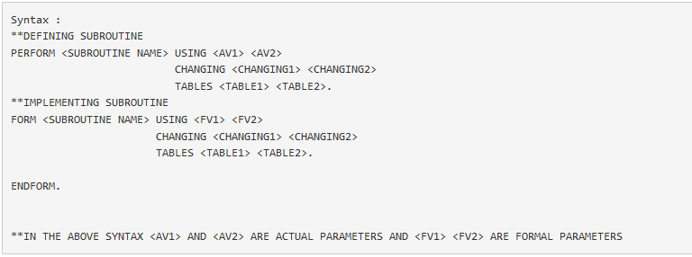
Passing variable / tables to subroutine

Slide 14
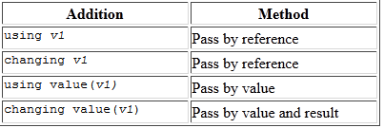

Slide 15
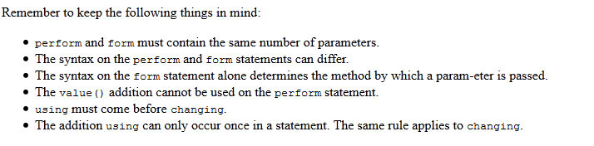

Slide 16
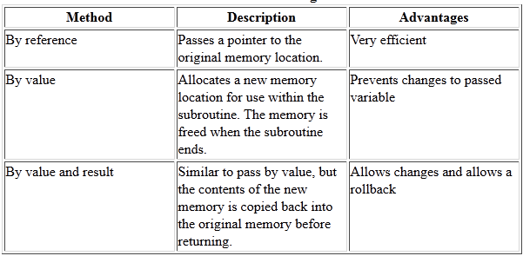

Slide 17
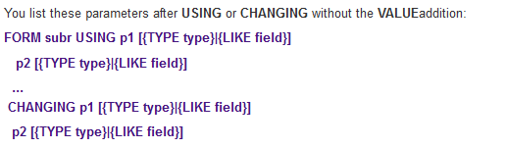
Using , changing and Tables are used to pass the data in subroutine.
There are 3 ways of passing variables.
Pass by reference: The formal parameter has no memory of its own. During a subroutine call, only the address of the actual parameter is transferred to the formal parameter. The subroutine works with the field from the calling program. If the value of the formal parameter changes, the contents of the actual parameter in the calling program also change.
Syntax:

Slide 18
Ex:
DATA : NUM TYPE I VALUE 5, FAC TYPE I VALUE 0. PERFORM FACT USING NUM CHANGING FAC. WRITE : / 'FACTORIAL' , NUM , '=' , FAC. *&---------------------------------------------------------------------* *& Form FACT *&---------------------------------------------------------------------* * text *----------------------------------------------------------------------* * -->P_NUM text * <--P_FAC text *----------------------------------------------------------------------* form FACT using p_num TYPE I changing p_fac TYPE I. p_fac = 1. WHILE p_NUM GE 1. p_fac = p_fac * p_NUM. p_NUM = p_NUM - 1. ENDWHILE. endform. " FACT

Slide 19
For calling by reference, USING and CHANGING are equivalent. For documentation purposes, you should use USING for input parameters which are not changed in the subroutine, and CHANGING for output parameters which are changed in the subroutine.
To avoid the value of an actual parameter being changed automatically, you must pass it by value.

Slide 20

Pass by value :
The formal parameter occupies its own memory space. When you call the subroutine, the value of the actual parameter is passed to the formal parameter. If the value of the formal parameter changes, this has no effect on the actual parameter.
Syntax : Input parameters that passes the value.

Slide 21

Output parameters that passes value :If the subroutine concludes successfully, that is, when the ENDFORM statement occurs, or when the subroutine is terminated through a CHECK or EXIT statement, the current value of the formal parameter is copied into the actual parameter.
If the subroutine terminates prematurely due to an error message, no value is passed.
Syntax :

Slide 22
Ex:
DATA : NUM TYPE I VALUE 5, FAC TYPE I VALUE 0. PERFORM FACT USING NUM CHANGING FAC. WRITE : / 'FACTORIAL' , NUM , '=' , FAC. *&---------------------------------------------------------------------* *& Form FACT *&---------------------------------------------------------------------* * text *----------------------------------------------------------------------* * -->P_NUM text * <--P_FAC text *----------------------------------------------------------------------* form FACT using value(p_num) TYPE I changing p_fac TYPE I. p_fac = 1. WHILE p_NUM GE 1. p_fac = p_fac * p_NUM. p_NUM = p_NUM - 1. ENDWHILE. endform. " FACT

Slide 23
Passing Parameters by Value and Result:
Pass by value and result is very similar to pass by value. Like pass by value, a new memory area is allocated and it holds an independent copy of the variable. It is freed when the subroutine ends, and that is also when the difference occurs.
When the endform statement executes, it copies the value of the local memory area back into the original memory area. Changes to the parameter within the subroutine are reflected in the original, but not until the subroutine returns.
The copy always takes place unless you leave the subroutine by using one of two statements:
stop
message ennn

Slide 24
Actual Parameters:
Actual parameters declared in main program.
Formal Parameters :
Formal parameters declared in subroutine to store the values of actual parameters.
--------------------------------------------------------------------------------
Using in internal Subroutine:
Syntax :
Perform <subroutine name > using < actual parameters>.
Form <subroutine name > using <formal parameters>.
---
Endform.

Slide 25
Ex:
DATA: A TYPE I VALUE 100,
B TYPE I VALUE 50,
C TYPE I.
C = A + B.
WRITE : / 'IN MAIN PROGRAM'.
WRITE : / A , '+' , B , '=' , C.
PERFORM SUB1 USING A B.
FORM SUB1 USING E TYPE I
F TYPE I.
DATA : Y TYPE I.
E = E / 2.
F = F / 2.
Y = E + F.
WRITE : / 'IN SUBROUTINE '.
WRITE: / E , '+' , F , '=' , Y.
ENDFORM.

Slide 26
Specifying the Type of Formal Parameters
Formal parameters can have any valid ABAP data type.
We can specify the type of a formal parameter using the TYPE or LIKE.
can specify the type either generically or in full.
Generic type :
If you specify a generic type, the type of the formal parameter is either partially specified or not specified at all. Any attributes that are not specified are inherited from the corresponding actual parameter when the subroutine is called.
any, c, numeric, or index table.
The actual parameter need only have the selection of attributes possessed by the formal parameter. The formal parameter adopts its remaining unnamed attributes from the actual parameter.
Note that formal parameters inherit the attributes of their corresponding actual parameters dynamically at runtime, and so they cannot be identified in the program code.

Slide 27
types: begin of t_line, col1 type c, col2 type c, end of t_line. data : wa type t_line, itab type hashed table of t_line with unique key col1, key(4) type c value 'col1'. wa-col1 = 'x'. wa-col2 = 'k'. insert wa into table itab. wa-col1 = 'y'. wa-col2 = 'm'. insert wa into table itab. wa-col1 = 'z'. wa-col2 = 'n'. insert wa into table itab. perform demo using itab. *&---------------------------------------------------------------------* *& Form DEMO *&---------------------------------------------------------------------* * text *----------------------------------------------------------------------* * -->P_ITAB text *----------------------------------------------------------------------* form DEMO using p_itab type any table. read table p_itab into wa with table key (key) = 'x'. write : / wa-col1 , wa-col2. endform. " DEMO
Note: The table key is addressed dynamically in the subroutine.
However, the static address
READ TABLE p WITH TABLE KEY col1 = 'X' INTO wa.
is syntactically incorrect, since the formal parameter P does not adopt the key of table itab until runtime.

Slide 28
Type full : If you specify the type fully, all of the technical attributes of the formal parameter are defined with the subroutine definition.
d, f, i, string, t, xstring.
The technical attributes of the actual parameter must match the attributes of the formal parameter.
Typed parameters have three advantages:
They are more efficient. Less CPU is needed to allocate memory for a typed parameter than an untyped one.
They help prevent coding errors. Because you cannot pass a parameter of an incompatible type, the syntax checker will point out the error to you if you try to pass an incompatible parameter.
They help prevent runtime errors. For example, if your program accepts an untyped variable and performs an arithmetic operation on it, it is possible to pass character data to that subroutine. If this happens at runtime, a short dump will result.

Slide 29
Using in External Subroutines :
Syntax :
Perform < subroutine name > (program name ) using <actual parameters>
or
Perform <subroutine name > in program(program name ) using
<actual parameters>

Slide 30
Ex:
Zprg4:
DATA: A TYPE I VALUE 100,
B TYPE I VALUE 50,
C TYPE I.
C = A + B.
WRITE : / 'IN MAIN PROGRAM'.
WRITE : / A , '+' , B , '=' , C.
PERFORM SUB1 USING A B.
PERFORM SUB2 IN PROGRAM ZPRG2 USING A B.
FORM SUB1 USING E TYPE I
F TYPE I.
DATA : Y TYPE I.
E = E / 2.
F = F / 2.
Y = E + F.
WRITE : / 'IN SUBROUTINE '.
WRITE: / E , '+' , F , '=' , Y.
ENDFORM.

Slide 31
FORM SUB2 USING H TYPE I
J TYPE I.
DATA : K TYPE I.
H = H / 2.
J = J / 2.
K = H + J.
WRITE : / 'IN EXTERNAL SUBROUTINE : '.
WRITE: / H , '+' , J , '=' , K.
ENDFORM.

Slide 32
Passing Internal Tables as Parameters
You can use one of two methods to pass an internal table to a subroutine:
Pass with header line
Pass body only
If the internal table has a header line, method 1 passes both the header line and the body to the subroutine. Method 2 passes only the body to the subroutine.
If the internal table doesn't have a header line, you can also use both methods. However, method 1 will behave a little differently-it will automatically create a header line for the internal table within the subroutine.

Slide 33
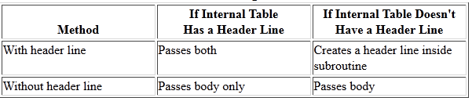
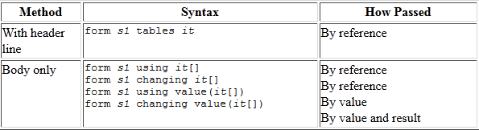
summarizes the effect of each of these methods on internal tables with and without header lines.
the syntax for each method of passing an internal table to a subroutine.

Slide 34
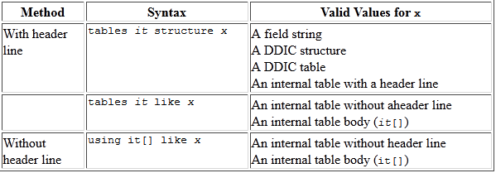
Syntax for Describing the Internal Table to the Subroutine

Slide 35
Table with header line.
DATA : ITAB LIKE MAKT OCCURS 5 WITH HEADER LINE . SELECT * FROM MAKT INTO TABLE ITAB UP TO 5 ROWS ORDER BY MATNR. PERFORM S1 TABLES ITAB. LOOP AT ITAB. WRITE : / ITAB-MATNR , ITAB-SPRAS , ITAB-MAKTX. ENDLOOP. form S1 tables p_itab structure MAKT. "Insert correct name for <...>. READ TABLE p_itab INDEX 3. IF SY-SUBRC = 0. p_itab-MATNR = '000000027'. MODIFY p_itab INDEX 3. ENDIF. endform. " S1

Slide 36
How to Pass an Internal Table Without a Header Line to a Subroutine and Automatically Create a Header Line.
TABLES : MAKT. DATA : ITAB LIKE MAKT OCCURS 5 . SELECT * FROM MAKT INTO TABLE ITAB UP TO 5 ROWS ORDER BY MATNR. PERFORM S1 TABLES ITAB. LOOP AT ITAB INTO MAKT. WRITE : / MAKT-MATNR , MAKT-SPRAS , MAKT-MAKTX. ENDLOOP. form S1 tables p_itab structure MAKT. "Insert correct name for <...>. READ TABLE p_itab INDEX 3. IF SY-SUBRC = 0. p_itab-MATNR = '000000027'. MODIFY p_itab INDEX 3. ENDIF. endform. " S1

Slide 37
How to Pass an Internal Table Without a Header Line to a Subroutine:
TABLES : MAKT. DATA : ITAB LIKE MAKT OCCURS 5. " INTERNAL TABLES WITHOUT WORK AREA. SELECT * FROM MAKT UP TO 5 ROWS INTO TABLE ITAB ORDER BY MATNR. PERFORM : S1 USING ITAB, S2 USING ITAB, S3 USING ITAB, PRINT TABLES ITAB. END-OF-SELECTION. WRITE : / 'END OF SELECTION'. PERFORM PRINT TABLES ITAB. *&---------------------------------------------------------------------* *& Form S1 *&---------------------------------------------------------------------* * text *----------------------------------------------------------------------* * -->P_ITAB text *----------------------------------------------------------------------* form S1 using VALUE(p_itab) LIKE ITAB. " PASS BY VALUE " ALSO YOU CAN USE LIKE ITAB[] DATA : WA LIKE LINE OF P_ITAB. READ TABLE P_ITAB INTO WA INDEX 1. IF SY-SUBRC = 0. WA-MATNR = '100'. MODIFY P_ITAB FROM WA INDEX 1. ENDIF. endform. " S1

Slide 38
form S2 using p_itab LIKE ITAB. " CALL BY REFERENCE DATA: WA LIKE LINE OF p_itab. READ TABLE p_itab INTO WA INDEX 3. IF SY-SUBRC = 0. WA-MATNR = '300'. MODIFY ITAB FROM WA INDEX 3. ENDIF. endform. " S2 *&---------------------------------------------------------------------* *----------------------------------------------------------------------* form S3 CHANGING VALUE(p_itab) LIKE ITAB. " CALL BY VALUE AND RESULT DATA : WA LIKE LINE OF P_ITAB. READ TABLE ITAB INTO WA INDEX 5. IF SY-SUBRC = 0. WA-MATNR = '700'. MODIFY ITAB FROM WA INDEX 5. ENDIF. endform. " S3 *&---------------------------------------------------------------------* *----------------------------------------------------------------------* form PRINT tables p_itab structure MAKT. "Insert correct name for <...>. LOOP AT P_ITAB. WRITE : / P_ITAB-MATNR , P_ITAB-SPRAS , P_ITAB-MAKTX. ENDLOOP. endform. " PRINT

Slide 39
Passing Internal table to internal subroutine:
Syntax :
Perform <subroutine name> tables <internal table name>.
Form <subroutine name> tables <internal table name>.
-----
Endform.

Slide 40
TYPES : BEGIN OF T_MARA,
MATNR TYPE MARA-MATNR,
ERSDA TYPE MARA-ERSDA,
ERNAM TYPE MARA-ERNAM,
END OF T_MARA.
DATA: ITAB TYPE TABLE OF T_MARA.
PERFORM FETCH.
PERFORM DISPLAY TABLES ITAB.

Slide 41
FORM FETCH .
SELECT MATNR ERSDA ERNAM FROM MARA INTO TABLE ITAB.
ENDFORM.
FORM DISPLAY TABLES P_ITAB LIKE ITAB.
DATA : WA LIKE LINE OF ITAB.
LOOP AT P_ITAB INTO WA.
WRITE : / WA-MATNR , WA-ERSDA , WA-ERNAM.
ENDLOOP.
ENDFORM. " DISPLAY

Slide 42
Passing Internal table to external subroutine :
Syntax :
Perform <subroutine name>(program name) tables <internal table name>
or
Perform <subroutine name> in program < program name >tables <internal table name>

Slide 43
Ex:
TABLES : MAKT. DATA : ITAB LIKE MAKT OCCURS 5 . SELECT * FROM MAKT INTO TABLE ITAB UP TO 5 ROWS ORDER BY MATNR. PERFORM S1 TABLES ITAB. PERFORM S2(ZPRG2) TABLES ITAB. LOOP AT ITAB INTO MAKT. WRITE : / MAKT-MATNR , MAKT-SPRAS , MAKT-MAKTX. ENDLOOP. *&---------------------------------------------------------------------* *& Form S1 *&---------------------------------------------------------------------* * text *----------------------------------------------------------------------* * -->P_ITAB text *----------------------------------------------------------------------* form S1 tables p_itab structure MAKT. "Insert correct name for <...>. READ TABLE p_itab INDEX 3. IF SY-SUBRC = 0. p_itab-MATNR = '000000027'. MODIFY p_itab INDEX 3. ENDIF. endform. " S1 ------------------------------------------------------------

Slide 44
REPORT ZPRG2. *&---------------------------------------------------------------------* *& Form S2 *&---------------------------------------------------------------------* * text *----------------------------------------------------------------------* * -->P_ITAB text *----------------------------------------------------------------------* form S2 tables p_itab structure MAKT. "Insert correct name for <...>. READ TABLE p_itab INDEX 5. IF SY-SUBRC = 0. P_ITAB-MATNR = '0000'. MODIFY p_itab INDEX 5. ENDIF. endform. " S2

Slide 45
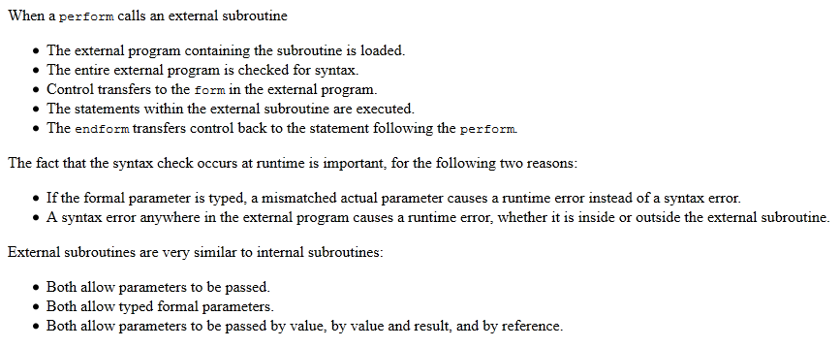

Slide 46
Function Module
It is very similar to an external subroutine in 3 ways:
Both exist within an external program.
Both enable parameters to be passed and returned.
Parameters can be passed by value, by value and result, or by reference.
The major differences between function modules and external subroutines:
Function modules have a special screen used for defining parameters-parameters are not defined via ABAP/4 statements.
tables work areas are not shared between the function module and the calling program.
Different syntax is used to call a function module than to call a subroutine.
Leaving a function module is accomplished via the raise statement instead of check, exit, or stop.

Slide 47
Transaction code SE37 (Function Builder) .
Function groups act as containers for function modules that logically belong together.
Function modules allow you to encapsulate and reuse global functions in the SAP System.
The SAP System contains several predefined functions modules that can be called from any ABAP program.
Function modules also play an important role during updating and in interaction between different SAP systems, or between SAP systems and remote systems through remote communications.

Slide 48
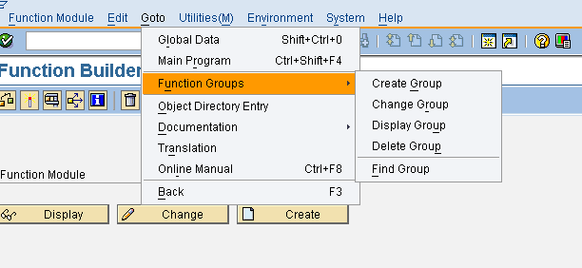
Function groups are containers for function modules. You cannot execute a function group.

Slide 49
Ex :function group name zfungroup .
Give short description name and save .
To activate the function group , go to SE38 .
SAPL<function group name > and click on activate.
System will create :
A main program.
A top include .
A UXX include .
A function module include.

Slide 50
To create function module :
SE37
Function module and give function group name , short description.
Save .
To pass parameters to a function module, we must define a function module interface.
Import parameters are variables or field strings that contain values passed into the function module from the calling program. These values originate outside of the function module and they are imported into it.

Slide 51
Export parameters are variables or field strings that contain values returned from the function module. These values originate within the function module and they are exported out of it.
Changing parameters are variables or field strings that contain values that are passed into the function module, changed by the code within the function module, and then returned. These values originate outside the function module. They are passed into it, changed, and passed back.
Table parameters are internal tables that are passed to the function module, changed within it, and returned. The internal tables must be defined in the calling program.
An exception is a name for an error that occurs within a function module. Exceptions are described in detail in the following section.

Slide 52
Passing parameters
The methods for passing parameters to function modules are very similar to those for passing parameters to external subroutines.
By default:
Import and export parameters are passed by value.
Changing parameters are passed by value and result.
Internal tables are passed by reference.

Slide 53
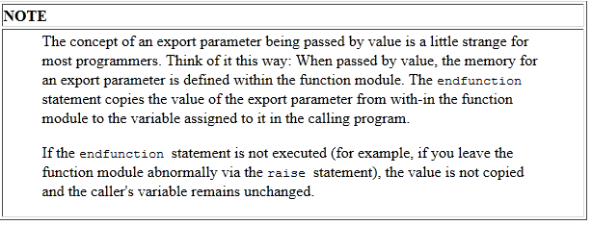
We can cause import, export, and changing parameters to be passed by reference by placing a tickmark in the Reference check box on the Import/Export Parameters screen.

Slide 54
Types of Functional module
3 types:
Normal functional Module: These are works within the system.
Remote-Enabled Module : function module that can be called from other SAP or non –SAP system. Ex : BAPI.
Update Function Module : It is basically used to bundle distributed updates within different programs spots, to one place (in FM). Update module in attributes of FM simply flags the FM not to be executed directly , hence can be only be excuted in update work process (using IN UPDATE TASK addition when calling FM) or in dialog work process (using SET UPDATE TASK LOCAL statement).

Slide 55
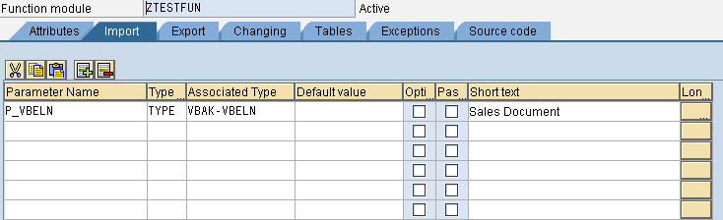
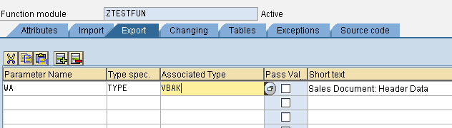
Normal Function Module :

Slide 56
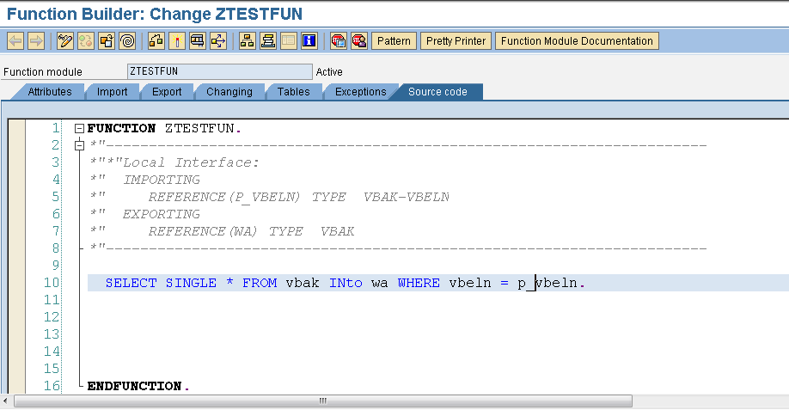

Slide 57
REPORT ZSTESR.
PARAMETERS : p_vbeln TYPE VBAK-VBELN.
DATA : WA TYPE VBAK.
CALL FUNCTION 'ZTESTFUN'
EXPORTING
P_VBELN = p_vbeln
IMPORTING
WA = WA
.
WRITE : / WA-VBELN , WA-ERDAT , WA-ERNAM , WA-NETWR.

Slide 58
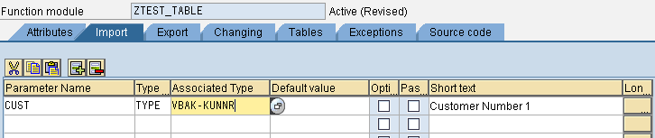
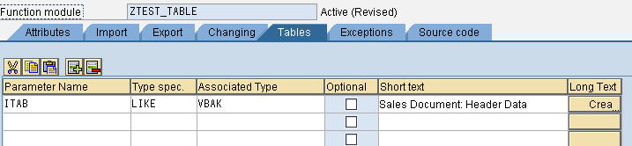
Ex : 2.

Slide 59
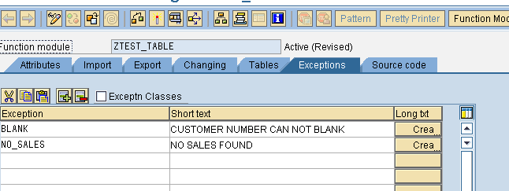
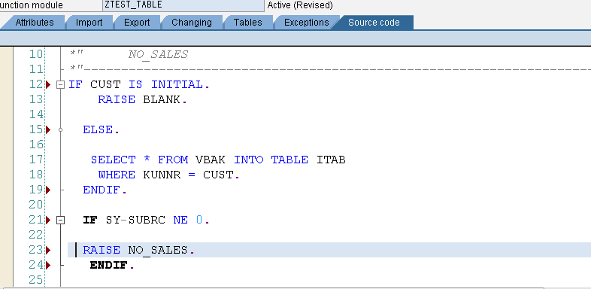

Slide 60
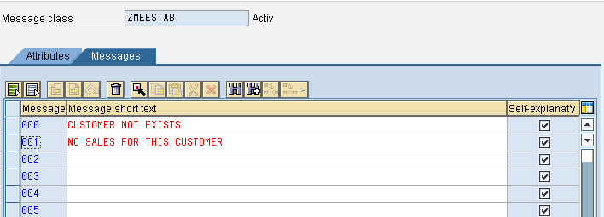
Message class (SE91).

Slide 61
5 types.
Error message. E
Information message. I
Status message. S
Warning message. W
Abort message. A
Syntax:
Message <message id >001(message class name) with ‘ <content>’ .

Slide 62
Message can divide into 4 parts.
To show values along with message use place holder.
Ex:
Message E001(zmessage) with p_bzirk.
In message class add using &.
Maximum 4 values can display in message.

Slide 63
REPORT ZCUST MESSAGE-ID ZMEESTAB.
PARAMETERS : CUSTOM TYPE KNA1-KUNNR.
DATA : ITAB TYPE TABLE OF VBAK,
WA TYPE VBAK.
START-OF-SELECTION.
CALL FUNCTION 'ZTEST_TABLE'
EXPORTING
CUST = CUSTOM
TABLES
ITAB = ITAB[]
EXCEPTIONS
BLANK = 1
NO_SALES = 2
OTHERS = 3
.
IF SY-SUBRC = 1.
MESSAGE I000.
ELSEIF SY-SUBRC = 2.
MESSAGE E001.
ENDIF.
LOOP AT ITAB INTO WA.
WRITE : / WA-VBELN , WA-KUNNR ,WA-BSTNK, WA-BSTDK.
ENDLOOP.

Slide 64
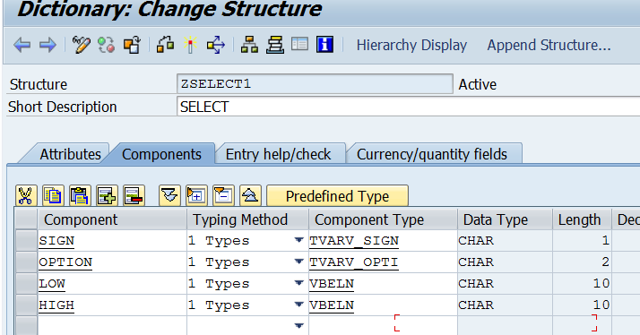
Select-option

Slide 65
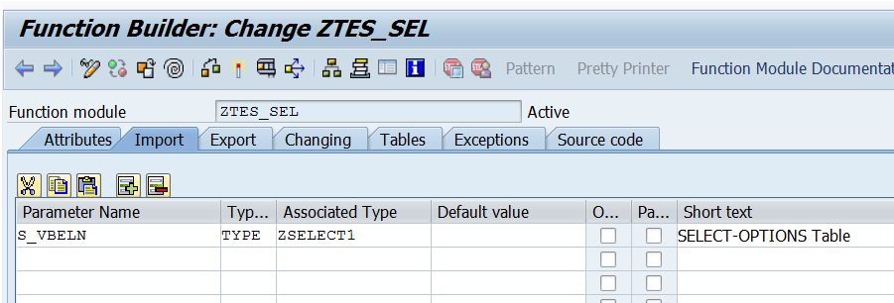

Slide 66
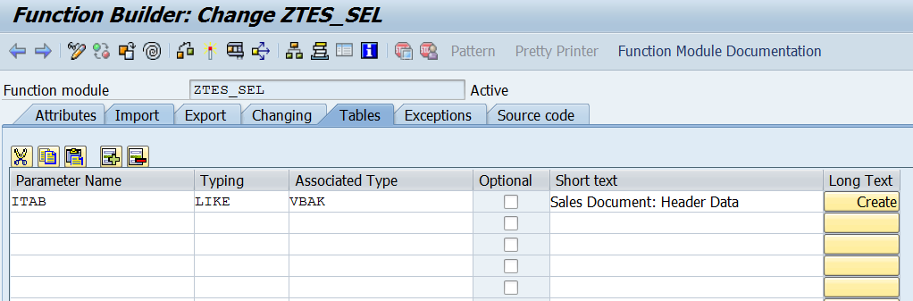

Slide 67
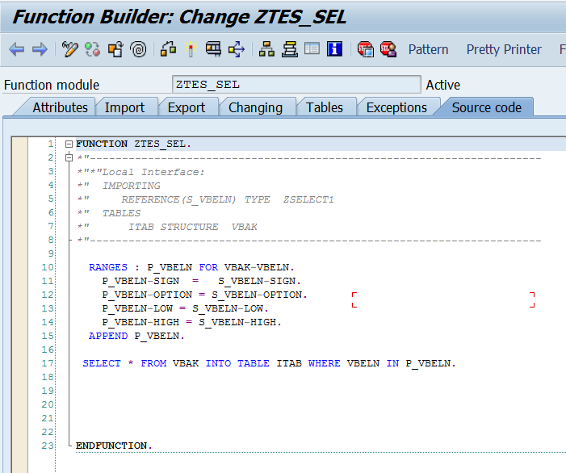

Slide 68
tables : vbak. data : itab type table of vbak. select-options : k_vbeln for vbak-vbeln. CALL FUNCTION 'ZTES_SEL' EXPORTING s_vbeln = k_vbeln tables itab = itab . LOOP AT itab into vbak. write :/ vbak-VBELN , vbak-ERDAT, vbak-ERNAM , vbak-SUBMI. ENDLOOP.

